Slide 1
Compliance: Appendix IV Review Types

Slide 2
Standard Reinsurance Agreement (SRA)
There are numerous monitoring, review, audit, and other oversight requirements in the Standard Reinsurance Agreement (SRA).
The SRA is the contract between the Federal government and the insurers.
In accordance with the SRA and Appendix IV, the Company will conduct all required compliance reviews and inspections.

Slide 3
Standard Reinsurance Agreement (SRA) - Required Reviews
The AIP is required to identify and conduct the following reviews in accordance with the SRA:
Individual Policy Reviews – Review of policies, entities, agents, loss adjusters, or affiliates identified by FCIC and determined necessary to protect program integrity.
Data Mining Reviews - Identifies policies for which anomalies have been identified by FCIC and require a review.
Spot Check List – Purpose is to deter potential fraud, waste, and abuse.
Agriculture Risk Protection Act (ARPA) – Identifies agents and adjusters with anomalous claim outcomes which warrant further investigation.
Excessive Yields - Individual yields on a year, county, crop-type-practice basis that are so large as to rise above an algorithmically determined threshold.

Slide 4
Standard Reinsurance Agreement (SRA) - Required Reviews (cont.)
Operational Reviews - Are intended to ensure that the Company’s internal controls are in place, operational, and provide reasonable assurance that the liability and indemnities are properly established in accordance with FCIC procedures.
Conflict of Interest – A review is mandatory if the producer reports a loss on the policy.
Consecutive Loss Adjuster - Conducted when a claim has been worked by the same adjuster for 3 consecutive claim years.
High Dollar Claim Reviews – Conducted if the claim amount paid is in excess of $200,000.
RMA has agreed to provide AIPs with reports to exclude non-anomalous policies from the $200K High Dollar Review requirements.
Prevented planting & harvest losses are calculated separately.
Rainfall Index and Vegetation Index Reviews: The review verifies the insurable interest/share in the crop and the insurability of acreage.

Slide 5
Non-SRA Required Review Types Utilized by RMA
The AIP is required to identify and conduct additional reviews as identified by RMA:
Program Reviews – A list is provided annually. Past examples include:
WFRP, Annual Forage, Dairy, Apiculture, Tobacco, Grapes, and Cotton
Data Mining Reviews
Isolated Prevented Planting (“only the lonely” and is applied by RMA on other than PP)
New Breaking/Native Sod
Misreported Claims (claim data not being carried forward to APH)
High Rated/High Risk Land
New Producer
Beginning Farmer/Rancher
Improper Payments
Delayed Claim/Delayed Notice

Slide 6
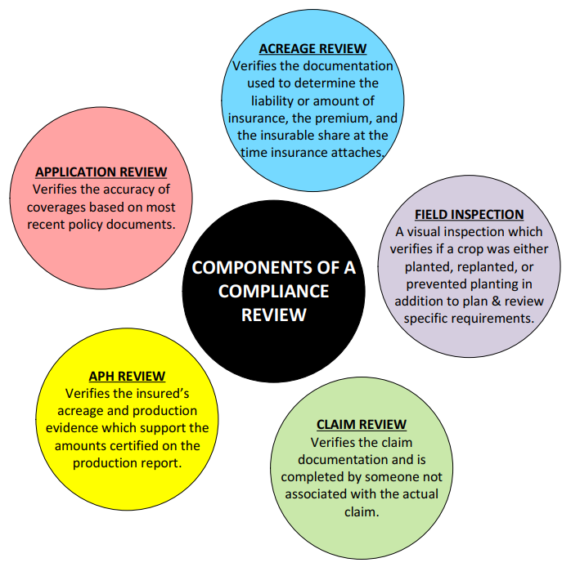
Components of a Compliance Review

Slide 7
APH Reviews
All APH Reviews are conducted by objective, unbiased persons who were not involved in establishing the guarantee, adjusting the loss this year, or in the sales (or supervision) of sales for the policies being reviewed.
Information required to complete an APH Review:
Documentation to verify insured’s reported acres.
Acceptable production evidence to support the amounts certified on the production report.
If any records, appear questionable or if the amount of production on any of the acceptable record(s) appears unreasonable, the AIP/RMA may require the insured to provide additional supporting documentation to verify the certified production and/or its actual disposition.

Slide 8
Acceptable Production Records
Examples of acceptable verifiable production records include:
Sold/Commercial Storage Records
Field Harvest Records
Farm Stored Records
Feeding Records
Pick Records
Sales Records
Automated Yield Monitoring System Records
Signed Appraisals

